Slide 1
Image Pre-Processing & Filtering
Note: course materials are prepared based 1) NYU Prof. Edward Wong and CMU Prof. Ioannis Computer Vision Class

Slide 2
Overview of today’s lecture
Types of image transformations.
Point image processing.
Linear shift-invariant image filtering.
Convolution.
Image gradients.

Slide 3
Slide credits
Most of these slides were adapted directly from:
Kris Kitani (15-463, Fall 2016).
Inspiration and some examples also came from:
Fredo Durand (Digital and Computational Photography, MIT).
Kayvon Fatahalian (15-769, Fall 2016).

Slide 4
Types of image transformations

Slide 5
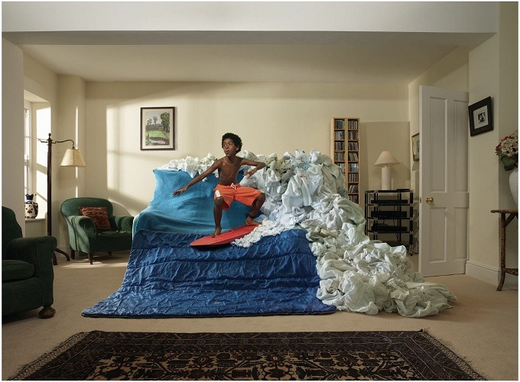
What is an image?

Slide 6


What is an image?
A (color) image is a 3D tensor of numbers.

Slide 7

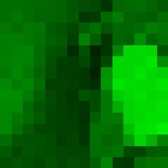




What is an image?
red
green
blue
Each channel
is a 2D array of numbers.
colorized for visualization
color image patch
How many bits are the intensity values?
actual intensity values per channel

Slide 8
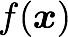
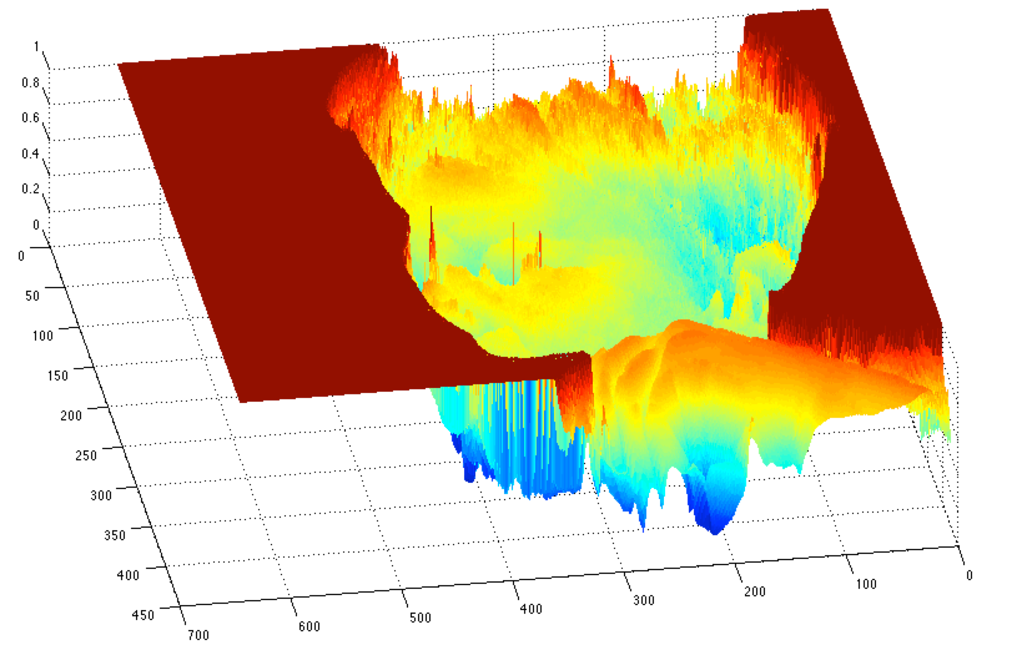
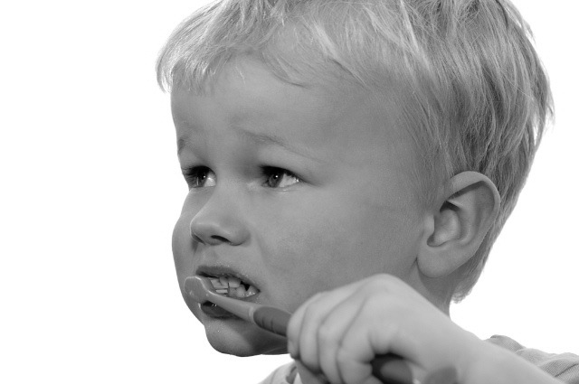
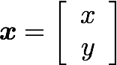
What is an image?
A (grayscale) image is a 2D function.
grayscale image
What is the range of the image function f?
domain

Slide 9
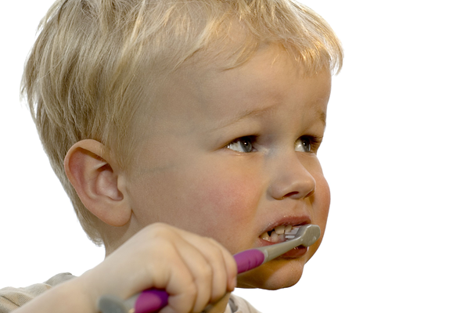
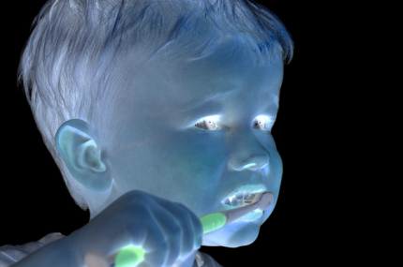
What types of image transformations can we do?
Filtering
Warping
changes pixel values
changes pixel locations

Slide 10
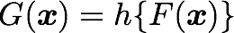
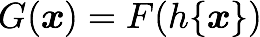
What types of image transformations can we do?
Filtering
Warping
changes range of image function
changes domain of image function

Slide 11
What types of image filtering can we do?
Point Operation
point processing
Neighborhood Operation
“filtering”

Slide 12
Point processing

Slide 13
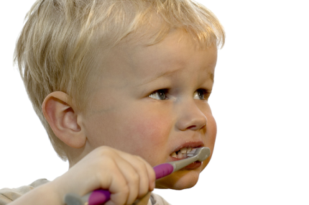
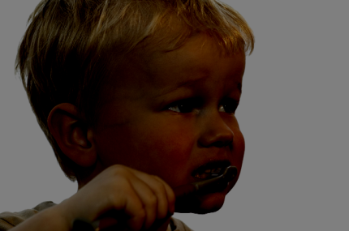

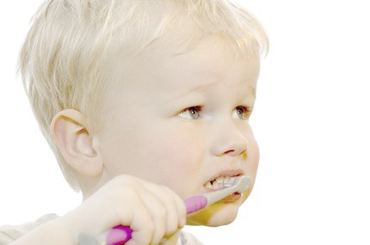
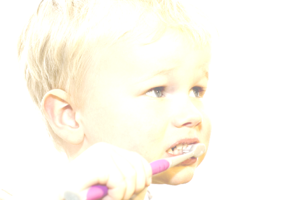

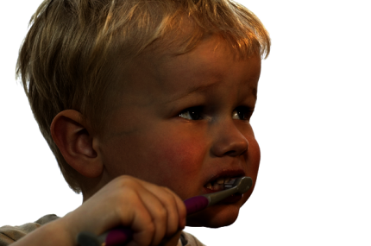
Examples of point processing
original
darken
lower contrast
non-linear lower contrast
invert
lighten
raise contrast
non-linear raise contrast

Slide 14
Examples of point processing
How would you implement these?
original
darken
lower contrast
non-linear lower contrast
invert
lighten
raise contrast
non-linear raise contrast

Slide 15
Examples of point processing
How would you implement these?
original
darken
lower contrast
non-linear lower contrast
invert
lighten
raise contrast
non-linear raise contrast

Slide 16
Examples of point processing
How would you implement these?
original
darken
lower contrast
non-linear lower contrast
invert
lighten
raise contrast
non-linear raise contrast

Slide 17
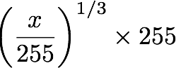
Examples of point processing
How would you implement these?
original
darken
lower contrast
non-linear lower contrast
invert
lighten
raise contrast
non-linear raise contrast

Slide 18
Examples of point processing
How would you implement these?
original
darken
lower contrast
non-linear lower contrast
invert
lighten
raise contrast
non-linear raise contrast

Slide 19
Examples of point processing
How would you implement these?
original
darken
lower contrast
non-linear lower contrast
invert
lighten
raise contrast
non-linear raise contrast

Slide 20
Examples of point processing
How would you implement these?
original
darken
lower contrast
non-linear lower contrast
invert
lighten
raise contrast
non-linear raise contrast

Slide 21
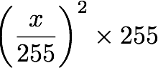
Examples of point processing
How would you implement these?
original
darken
lower contrast
non-linear lower contrast
invert
lighten
raise contrast
non-linear raise contrast

Slide 22
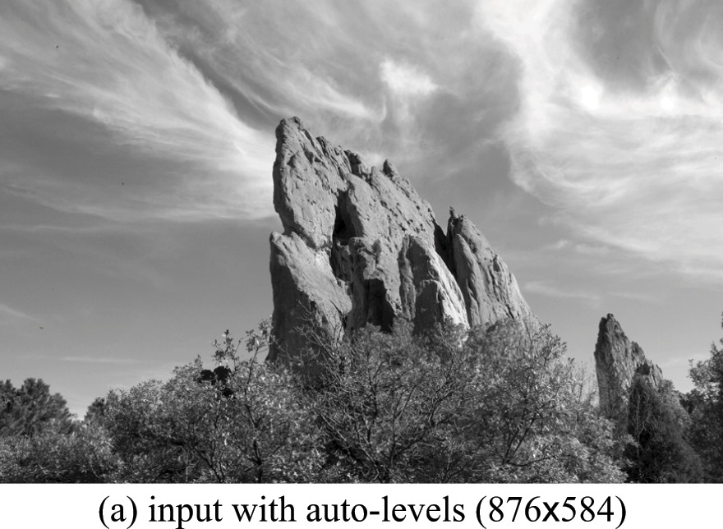
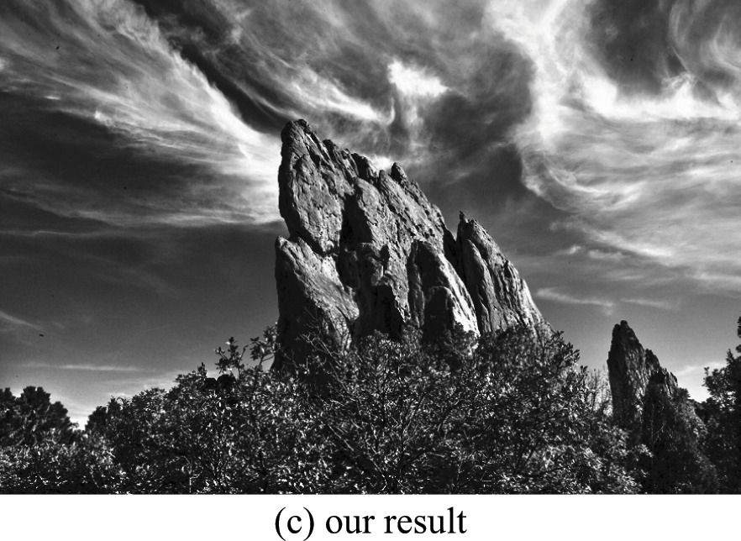
Many other types of point processing
camera output
image after stylistic tonemapping
[Bae et al., SIGGRAPH 2006]

Slide 23
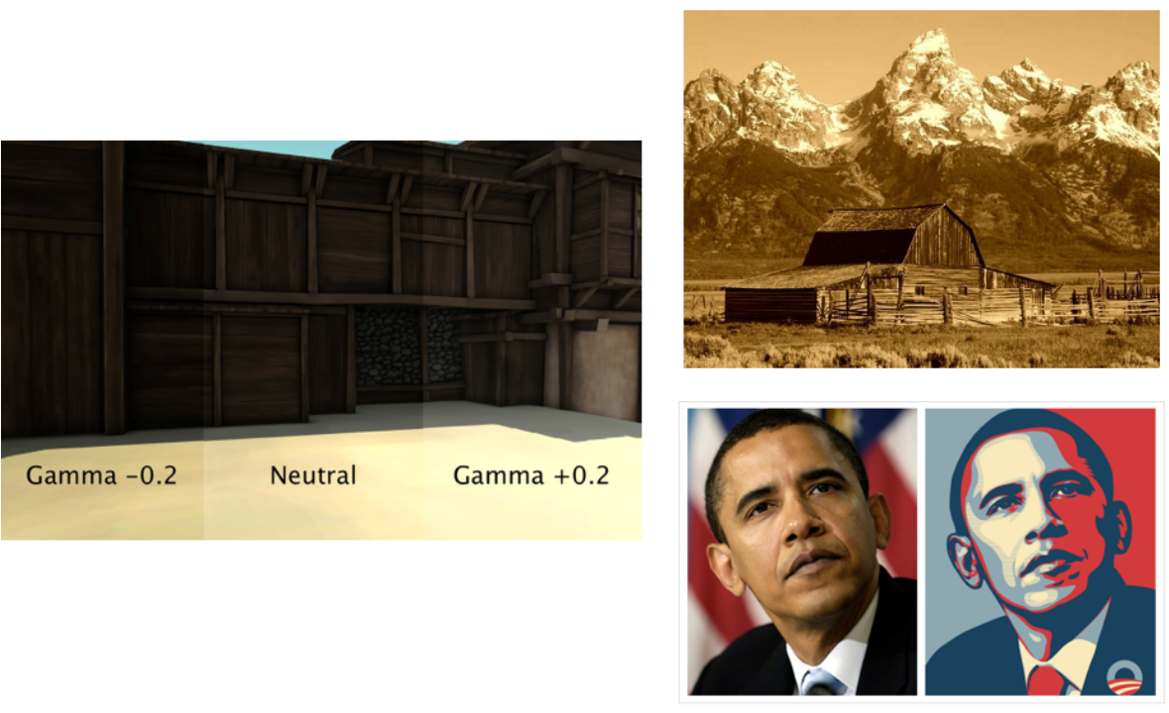
Many other types of point processing

Slide 24
Linear shift-invariant image filtering

Slide 25
Linear shift-invariant image filtering
Replace each pixel by a linear combination of its neighbors (and possibly itself).
The combination is determined by the filter’s kernel.
The same kernel is shifted to all pixel locations so that all pixels use the same linear combination of their neighbors.

Slide 26

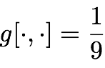
Example: the box filter
also known as the 2D rect (not rekt) filter
also known as the square mean filter
kernel
1 | 1 | 1
1 | 1 | 1
1 | 1 | 1
replaces pixel with local average
has smoothing (blurring) effect

Slide 27
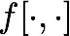
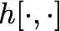
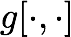
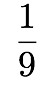
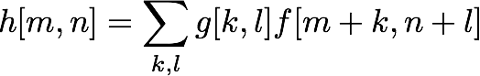
Let’s run the box filter
image
output
0 | 0 | 0 | 0 | 0 | 0 | 0 | 0 | 0 | 0
0 | 0 | 0 | 0 | 0 | 0 | 0 | 0 | 0 | 0
0 | 0 | 0 | 90 | 90 | 90 | 90 | 90 | 0 | 0
0 | 0 | 0 | 90 | 90 | 90 | 90 | 90 | 0 | 0
0 | 0 | 0 | 90 | 0 | 90 | 90 | 90 | 0 | 0
0 | 0 | 0 | 90 | 90 | 90 | 90 | 90 | 0 | 0
0 | 0 | 0 | 0 | 0 | 0 | 0 | 0 | 0 | 0
0 | 0 | 0 | 0 | 0 | 0 | 0 | 0 | 0 | 0
0 | 0 | 90 | 0 | 0 | 0 | 0 | 0 | 0 | 0
0 | 0 | 0 | 0 | 0 | 0 | 0 | 0 | 0 | 0
kernel
1 | 1 | 1
1 | 1 | 1
1 | 1 | 1
note that we assume that the kernel coordinates are centered
output
filter
image (signal)

Slide 28
Let’s run the box filter
image
output
0 | 0 | 0 | 0 | 0 | 0 | 0 | 0 | 0 | 0
0 | 0 | 0 | 0 | 0 | 0 | 0 | 0 | 0 | 0
0 | 0 | 0 | 90 | 90 | 90 | 90 | 90 | 0 | 0
0 | 0 | 0 | 90 | 90 | 90 | 90 | 90 | 0 | 0
0 | 0 | 0 | 90 | 0 | 90 | 90 | 90 | 0 | 0
0 | 0 | 0 | 90 | 90 | 90 | 90 | 90 | 0 | 0
0 | 0 | 0 | 0 | 0 | 0 | 0 | 0 | 0 | 0
0 | 0 | 0 | 0 | 0 | 0 | 0 | 0 | 0 | 0
0 | 0 | 90 | 0 | 0 | 0 | 0 | 0 | 0 | 0
0 | 0 | 0 | 0 | 0 | 0 | 0 | 0 | 0 | 0
 | 0
kernel
1 | 1 | 1
1 | 1 | 1
1 | 1 | 1
output
filter
image (signal)

Slide 29
Let’s run the box filter
image
output
0 | 0 | 0 | 0 | 0 | 0 | 0 | 0 | 0 | 0
0 | 0 | 0 | 0 | 0 | 0 | 0 | 0 | 0 | 0
0 | 0 | 0 | 90 | 90 | 90 | 90 | 90 | 0 | 0
0 | 0 | 0 | 90 | 90 | 90 | 90 | 90 | 0 | 0
0 | 0 | 0 | 90 | 0 | 90 | 90 | 90 | 0 | 0
0 | 0 | 0 | 90 | 90 | 90 | 90 | 90 | 0 | 0
0 | 0 | 0 | 0 | 0 | 0 | 0 | 0 | 0 | 0
0 | 0 | 0 | 0 | 0 | 0 | 0 | 0 | 0 | 0
0 | 0 | 90 | 0 | 0 | 0 | 0 | 0 | 0 | 0
0 | 0 | 0 | 0 | 0 | 0 | 0 | 0 | 0 | 0
 | 0
kernel
1 | 1 | 1
1 | 1 | 1
1 | 1 | 1
shift-invariant: as the pixel shifts, so does the kernel
output
filter
image (signal)

Slide 30
Let’s run the box filter
image
output
0 | 0 | 0 | 0 | 0 | 0 | 0 | 0 | 0 | 0
0 | 0 | 0 | 0 | 0 | 0 | 0 | 0 | 0 | 0
0 | 0 | 0 | 90 | 90 | 90 | 90 | 90 | 0 | 0
0 | 0 | 0 | 90 | 90 | 90 | 90 | 90 | 0 | 0
0 | 0 | 0 | 90 | 0 | 90 | 90 | 90 | 0 | 0
0 | 0 | 0 | 90 | 90 | 90 | 90 | 90 | 0 | 0
0 | 0 | 0 | 0 | 0 | 0 | 0 | 0 | 0 | 0
0 | 0 | 0 | 0 | 0 | 0 | 0 | 0 | 0 | 0
0 | 0 | 90 | 0 | 0 | 0 | 0 | 0 | 0 | 0
0 | 0 | 0 | 0 | 0 | 0 | 0 | 0 | 0 | 0
 | 0 | 10
kernel
1 | 1 | 1
1 | 1 | 1
1 | 1 | 1
output
filter
image (signal)

Slide 31
Let’s run the box filter
image
output
0 | 0 | 0 | 0 | 0 | 0 | 0 | 0 | 0 | 0
0 | 0 | 0 | 0 | 0 | 0 | 0 | 0 | 0 | 0
0 | 0 | 0 | 90 | 90 | 90 | 90 | 90 | 0 | 0
0 | 0 | 0 | 90 | 90 | 90 | 90 | 90 | 0 | 0
0 | 0 | 0 | 90 | 0 | 90 | 90 | 90 | 0 | 0
0 | 0 | 0 | 90 | 90 | 90 | 90 | 90 | 0 | 0
0 | 0 | 0 | 0 | 0 | 0 | 0 | 0 | 0 | 0
0 | 0 | 0 | 0 | 0 | 0 | 0 | 0 | 0 | 0
0 | 0 | 90 | 0 | 0 | 0 | 0 | 0 | 0 | 0
0 | 0 | 0 | 0 | 0 | 0 | 0 | 0 | 0 | 0
 | 0 | 10
kernel
1 | 1 | 1
1 | 1 | 1
1 | 1 | 1
output
filter
image (signal)

Slide 32
Let’s run the box filter
image
output
0 | 0 | 0 | 0 | 0 | 0 | 0 | 0 | 0 | 0
0 | 0 | 0 | 0 | 0 | 0 | 0 | 0 | 0 | 0
0 | 0 | 0 | 90 | 90 | 90 | 90 | 90 | 0 | 0
0 | 0 | 0 | 90 | 90 | 90 | 90 | 90 | 0 | 0
0 | 0 | 0 | 90 | 0 | 90 | 90 | 90 | 0 | 0
0 | 0 | 0 | 90 | 90 | 90 | 90 | 90 | 0 | 0
0 | 0 | 0 | 0 | 0 | 0 | 0 | 0 | 0 | 0
0 | 0 | 0 | 0 | 0 | 0 | 0 | 0 | 0 | 0
0 | 0 | 90 | 0 | 0 | 0 | 0 | 0 | 0 | 0
0 | 0 | 0 | 0 | 0 | 0 | 0 | 0 | 0 | 0
 | 0 | 10 | 20
kernel
1 | 1 | 1
1 | 1 | 1
1 | 1 | 1
output
filter
image (signal)

Slide 33
Let’s run the box filter
image
output
0 | 0 | 0 | 0 | 0 | 0 | 0 | 0 | 0 | 0
0 | 0 | 0 | 0 | 0 | 0 | 0 | 0 | 0 | 0
0 | 0 | 0 | 90 | 90 | 90 | 90 | 90 | 0 | 0
0 | 0 | 0 | 90 | 90 | 90 | 90 | 90 | 0 | 0
0 | 0 | 0 | 90 | 0 | 90 | 90 | 90 | 0 | 0
0 | 0 | 0 | 90 | 90 | 90 | 90 | 90 | 0 | 0
0 | 0 | 0 | 0 | 0 | 0 | 0 | 0 | 0 | 0
0 | 0 | 0 | 0 | 0 | 0 | 0 | 0 | 0 | 0
0 | 0 | 90 | 0 | 0 | 0 | 0 | 0 | 0 | 0
0 | 0 | 0 | 0 | 0 | 0 | 0 | 0 | 0 | 0
 | 0 | 10 | 20
kernel
1 | 1 | 1
1 | 1 | 1
1 | 1 | 1
output
filter
image (signal)

Slide 34
Let’s run the box filter
image
output
0 | 0 | 0 | 0 | 0 | 0 | 0 | 0 | 0 | 0
0 | 0 | 0 | 0 | 0 | 0 | 0 | 0 | 0 | 0
0 | 0 | 0 | 90 | 90 | 90 | 90 | 90 | 0 | 0
0 | 0 | 0 | 90 | 90 | 90 | 90 | 90 | 0 | 0
0 | 0 | 0 | 90 | 0 | 90 | 90 | 90 | 0 | 0
0 | 0 | 0 | 90 | 90 | 90 | 90 | 90 | 0 | 0
0 | 0 | 0 | 0 | 0 | 0 | 0 | 0 | 0 | 0
0 | 0 | 0 | 0 | 0 | 0 | 0 | 0 | 0 | 0
0 | 0 | 90 | 0 | 0 | 0 | 0 | 0 | 0 | 0
0 | 0 | 0 | 0 | 0 | 0 | 0 | 0 | 0 | 0
 | 0 | 10 | 20 | 30
kernel
1 | 1 | 1
1 | 1 | 1
1 | 1 | 1
output
filter
image (signal)

Slide 35
Let’s run the box filter
image
output
0 | 0 | 0 | 0 | 0 | 0 | 0 | 0 | 0 | 0
0 | 0 | 0 | 0 | 0 | 0 | 0 | 0 | 0 | 0
0 | 0 | 0 | 90 | 90 | 90 | 90 | 90 | 0 | 0
0 | 0 | 0 | 90 | 90 | 90 | 90 | 90 | 0 | 0
0 | 0 | 0 | 90 | 0 | 90 | 90 | 90 | 0 | 0
0 | 0 | 0 | 90 | 90 | 90 | 90 | 90 | 0 | 0
0 | 0 | 0 | 0 | 0 | 0 | 0 | 0 | 0 | 0
0 | 0 | 0 | 0 | 0 | 0 | 0 | 0 | 0 | 0
0 | 0 | 90 | 0 | 0 | 0 | 0 | 0 | 0 | 0
0 | 0 | 0 | 0 | 0 | 0 | 0 | 0 | 0 | 0
 | 0 | 10 | 20 | 30 | 30
kernel
1 | 1 | 1
1 | 1 | 1
1 | 1 | 1
output
filter
image (signal)

Slide 36
Let’s run the box filter
image
output
0 | 0 | 0 | 0 | 0 | 0 | 0 | 0 | 0 | 0
0 | 0 | 0 | 0 | 0 | 0 | 0 | 0 | 0 | 0
0 | 0 | 0 | 90 | 90 | 90 | 90 | 90 | 0 | 0
0 | 0 | 0 | 90 | 90 | 90 | 90 | 90 | 0 | 0
0 | 0 | 0 | 90 | 0 | 90 | 90 | 90 | 0 | 0
0 | 0 | 0 | 90 | 90 | 90 | 90 | 90 | 0 | 0
0 | 0 | 0 | 0 | 0 | 0 | 0 | 0 | 0 | 0
0 | 0 | 0 | 0 | 0 | 0 | 0 | 0 | 0 | 0
0 | 0 | 90 | 0 | 0 | 0 | 0 | 0 | 0 | 0
0 | 0 | 0 | 0 | 0 | 0 | 0 | 0 | 0 | 0
 | 0 | 10 | 20 | 30 | 30 | 30
kernel
1 | 1 | 1
1 | 1 | 1
1 | 1 | 1
output
filter
image (signal)

Slide 37
Let’s run the box filter
image
output
0 | 0 | 0 | 0 | 0 | 0 | 0 | 0 | 0 | 0
0 | 0 | 0 | 0 | 0 | 0 | 0 | 0 | 0 | 0
0 | 0 | 0 | 90 | 90 | 90 | 90 | 90 | 0 | 0
0 | 0 | 0 | 90 | 90 | 90 | 90 | 90 | 0 | 0
0 | 0 | 0 | 90 | 0 | 90 | 90 | 90 | 0 | 0
0 | 0 | 0 | 90 | 90 | 90 | 90 | 90 | 0 | 0
0 | 0 | 0 | 0 | 0 | 0 | 0 | 0 | 0 | 0
0 | 0 | 0 | 0 | 0 | 0 | 0 | 0 | 0 | 0
0 | 0 | 90 | 0 | 0 | 0 | 0 | 0 | 0 | 0
0 | 0 | 0 | 0 | 0 | 0 | 0 | 0 | 0 | 0
 | 0 | 10 | 20 | 30 | 30 | 30 | 20
kernel
1 | 1 | 1
1 | 1 | 1
1 | 1 | 1
output
filter
image (signal)

Slide 38
Let’s run the box filter
image
output
0 | 0 | 0 | 0 | 0 | 0 | 0 | 0 | 0 | 0
0 | 0 | 0 | 0 | 0 | 0 | 0 | 0 | 0 | 0
0 | 0 | 0 | 90 | 90 | 90 | 90 | 90 | 0 | 0
0 | 0 | 0 | 90 | 90 | 90 | 90 | 90 | 0 | 0
0 | 0 | 0 | 90 | 0 | 90 | 90 | 90 | 0 | 0
0 | 0 | 0 | 90 | 90 | 90 | 90 | 90 | 0 | 0
0 | 0 | 0 | 0 | 0 | 0 | 0 | 0 | 0 | 0
0 | 0 | 0 | 0 | 0 | 0 | 0 | 0 | 0 | 0
0 | 0 | 90 | 0 | 0 | 0 | 0 | 0 | 0 | 0
0 | 0 | 0 | 0 | 0 | 0 | 0 | 0 | 0 | 0
 | 0 | 10 | 20 | 30 | 30 | 30 | 20 | 10
kernel
1 | 1 | 1
1 | 1 | 1
1 | 1 | 1
output
filter
image (signal)

Slide 39
Let’s run the box filter
image
output
0 | 0 | 0 | 0 | 0 | 0 | 0 | 0 | 0 | 0
0 | 0 | 0 | 0 | 0 | 0 | 0 | 0 | 0 | 0
0 | 0 | 0 | 90 | 90 | 90 | 90 | 90 | 0 | 0
0 | 0 | 0 | 90 | 90 | 90 | 90 | 90 | 0 | 0
0 | 0 | 0 | 90 | 0 | 90 | 90 | 90 | 0 | 0
0 | 0 | 0 | 90 | 90 | 90 | 90 | 90 | 0 | 0
0 | 0 | 0 | 0 | 0 | 0 | 0 | 0 | 0 | 0
0 | 0 | 0 | 0 | 0 | 0 | 0 | 0 | 0 | 0
0 | 0 | 90 | 0 | 0 | 0 | 0 | 0 | 0 | 0
0 | 0 | 0 | 0 | 0 | 0 | 0 | 0 | 0 | 0
 | 0 | 10 | 20 | 30 | 30 | 30 | 20 | 10
 | 0
kernel
1 | 1 | 1
1 | 1 | 1
1 | 1 | 1
output
filter
image (signal)

Slide 40
Let’s run the box filter
image
output
0 | 0 | 0 | 0 | 0 | 0 | 0 | 0 | 0 | 0
0 | 0 | 0 | 0 | 0 | 0 | 0 | 0 | 0 | 0
0 | 0 | 0 | 90 | 90 | 90 | 90 | 90 | 0 | 0
0 | 0 | 0 | 90 | 90 | 90 | 90 | 90 | 0 | 0
0 | 0 | 0 | 90 | 0 | 90 | 90 | 90 | 0 | 0
0 | 0 | 0 | 90 | 90 | 90 | 90 | 90 | 0 | 0
0 | 0 | 0 | 0 | 0 | 0 | 0 | 0 | 0 | 0
0 | 0 | 0 | 0 | 0 | 0 | 0 | 0 | 0 | 0
0 | 0 | 90 | 0 | 0 | 0 | 0 | 0 | 0 | 0
0 | 0 | 0 | 0 | 0 | 0 | 0 | 0 | 0 | 0
 | 0 | 10 | 20 | 30 | 30 | 30 | 20 | 10
 | 0 | 20
kernel
1 | 1 | 1
1 | 1 | 1
1 | 1 | 1
output
filter
image (signal)

Slide 41
Let’s run the box filter
image
output
0 | 0 | 0 | 0 | 0 | 0 | 0 | 0 | 0 | 0
0 | 0 | 0 | 0 | 0 | 0 | 0 | 0 | 0 | 0
0 | 0 | 0 | 90 | 90 | 90 | 90 | 90 | 0 | 0
0 | 0 | 0 | 90 | 90 | 90 | 90 | 90 | 0 | 0
0 | 0 | 0 | 90 | 0 | 90 | 90 | 90 | 0 | 0
0 | 0 | 0 | 90 | 90 | 90 | 90 | 90 | 0 | 0
0 | 0 | 0 | 0 | 0 | 0 | 0 | 0 | 0 | 0
0 | 0 | 0 | 0 | 0 | 0 | 0 | 0 | 0 | 0
0 | 0 | 90 | 0 | 0 | 0 | 0 | 0 | 0 | 0
0 | 0 | 0 | 0 | 0 | 0 | 0 | 0 | 0 | 0
 | 0 | 10 | 20 | 30 | 30 | 30 | 20 | 10
 | 0 | 20 | 40
kernel
1 | 1 | 1
1 | 1 | 1
1 | 1 | 1
output
filter
image (signal)

Slide 42
Let’s run the box filter
image
output
0 | 0 | 0 | 0 | 0 | 0 | 0 | 0 | 0 | 0
0 | 0 | 0 | 0 | 0 | 0 | 0 | 0 | 0 | 0
0 | 0 | 0 | 90 | 90 | 90 | 90 | 90 | 0 | 0
0 | 0 | 0 | 90 | 90 | 90 | 90 | 90 | 0 | 0
0 | 0 | 0 | 90 | 0 | 90 | 90 | 90 | 0 | 0
0 | 0 | 0 | 90 | 90 | 90 | 90 | 90 | 0 | 0
0 | 0 | 0 | 0 | 0 | 0 | 0 | 0 | 0 | 0
0 | 0 | 0 | 0 | 0 | 0 | 0 | 0 | 0 | 0
0 | 0 | 90 | 0 | 0 | 0 | 0 | 0 | 0 | 0
0 | 0 | 0 | 0 | 0 | 0 | 0 | 0 | 0 | 0
 | 0 | 10 | 20 | 30 | 30 | 30 | 20 | 10
 | 0 | 20 | 40 | 60 | 60 | 60 | 40 | 20
 | 0
kernel
1 | 1 | 1
1 | 1 | 1
1 | 1 | 1
output
filter
image (signal)

Slide 43
Let’s run the box filter
image
output
0 | 0 | 0 | 0 | 0 | 0 | 0 | 0 | 0 | 0
0 | 0 | 0 | 0 | 0 | 0 | 0 | 0 | 0 | 0
0 | 0 | 0 | 90 | 90 | 90 | 90 | 90 | 0 | 0
0 | 0 | 0 | 90 | 90 | 90 | 90 | 90 | 0 | 0
0 | 0 | 0 | 90 | 0 | 90 | 90 | 90 | 0 | 0
0 | 0 | 0 | 90 | 90 | 90 | 90 | 90 | 0 | 0
0 | 0 | 0 | 0 | 0 | 0 | 0 | 0 | 0 | 0
0 | 0 | 0 | 0 | 0 | 0 | 0 | 0 | 0 | 0
0 | 0 | 90 | 0 | 0 | 0 | 0 | 0 | 0 | 0
0 | 0 | 0 | 0 | 0 | 0 | 0 | 0 | 0 | 0
 | 0 | 10 | 20 | 30 | 30 | 30 | 20 | 10
 | 0 | 20 | 40 | 60 | 60 | 60 | 40 | 20
 | 0 | 30
kernel
1 | 1 | 1
1 | 1 | 1
1 | 1 | 1
output
filter
image (signal)

Slide 44
Let’s run the box filter
image
output
0 | 0 | 0 | 0 | 0 | 0 | 0 | 0 | 0 | 0
0 | 0 | 0 | 0 | 0 | 0 | 0 | 0 | 0 | 0
0 | 0 | 0 | 90 | 90 | 90 | 90 | 90 | 0 | 0
0 | 0 | 0 | 90 | 90 | 90 | 90 | 90 | 0 | 0
0 | 0 | 0 | 90 | 0 | 90 | 90 | 90 | 0 | 0
0 | 0 | 0 | 90 | 90 | 90 | 90 | 90 | 0 | 0
0 | 0 | 0 | 0 | 0 | 0 | 0 | 0 | 0 | 0
0 | 0 | 0 | 0 | 0 | 0 | 0 | 0 | 0 | 0
0 | 0 | 90 | 0 | 0 | 0 | 0 | 0 | 0 | 0
0 | 0 | 0 | 0 | 0 | 0 | 0 | 0 | 0 | 0
 | 0 | 10 | 20 | 30 | 30 | 30 | 20 | 10
 | 0 | 20 | 40 | 60 | 60 | 60 | 40 | 20
 | 0 | 30 | 50 | 80 | 80 | 90 | 60 | 30
 | 0 | 30 | 50 | 80 | 80 | 90 | 60 | 30
 | 0 | 20 | 30 | 50 | 50 | 60 | 40 | 20
 | 0 | 10 | 20 | 30 | 30 | 30 | 20 | 10
 | 10 | 10 | 10 | 10 | 0 | 0 | 0 | 0
 | 10
kernel
1 | 1 | 1
1 | 1 | 1
1 | 1 | 1
output
filter
image (signal)

Slide 45
Let’s run the box filter
image
output
0 | 0 | 0 | 0 | 0 | 0 | 0 | 0 | 0 | 0
0 | 0 | 0 | 0 | 0 | 0 | 0 | 0 | 0 | 0
0 | 0 | 0 | 90 | 90 | 90 | 90 | 90 | 0 | 0
0 | 0 | 0 | 90 | 90 | 90 | 90 | 90 | 0 | 0
0 | 0 | 0 | 90 | 0 | 90 | 90 | 90 | 0 | 0
0 | 0 | 0 | 90 | 90 | 90 | 90 | 90 | 0 | 0
0 | 0 | 0 | 0 | 0 | 0 | 0 | 0 | 0 | 0
0 | 0 | 0 | 0 | 0 | 0 | 0 | 0 | 0 | 0
0 | 0 | 90 | 0 | 0 | 0 | 0 | 0 | 0 | 0
0 | 0 | 0 | 0 | 0 | 0 | 0 | 0 | 0 | 0
 | 0 | 10 | 20 | 30 | 30 | 30 | 20 | 10
 | 0 | 20 | 40 | 60 | 60 | 60 | 40 | 20
 | 0 | 30 | 50 | 80 | 80 | 90 | 60 | 30
 | 0 | 30 | 50 | 80 | 80 | 90 | 60 | 30
 | 0 | 20 | 30 | 50 | 50 | 60 | 40 | 20
 | 0 | 10 | 20 | 30 | 30 | 30 | 20 | 10
 | 10 | 10 | 10 | 10 | 0 | 0 | 0 | 0
 | 10 | 10 | 10 | 10 | 0 | 0 | 0 | 0
kernel
1 | 1 | 1
1 | 1 | 1
1 | 1 | 1
output
filter
image (signal)

Slide 46
… and the result is
image
output
0 | 0 | 0 | 0 | 0 | 0 | 0 | 0 | 0 | 0
0 | 0 | 0 | 0 | 0 | 0 | 0 | 0 | 0 | 0
0 | 0 | 0 | 90 | 90 | 90 | 90 | 90 | 0 | 0
0 | 0 | 0 | 90 | 90 | 90 | 90 | 90 | 0 | 0
0 | 0 | 0 | 90 | 0 | 90 | 90 | 90 | 0 | 0
0 | 0 | 0 | 90 | 90 | 90 | 90 | 90 | 0 | 0
0 | 0 | 0 | 0 | 0 | 0 | 0 | 0 | 0 | 0
0 | 0 | 0 | 0 | 0 | 0 | 0 | 0 | 0 | 0
0 | 0 | 90 | 0 | 0 | 0 | 0 | 0 | 0 | 0
0 | 0 | 0 | 0 | 0 | 0 | 0 | 0 | 0 | 0
 | 0 | 10 | 20 | 30 | 30 | 30 | 20 | 10
 | 0 | 20 | 40 | 60 | 60 | 60 | 40 | 20
 | 0 | 30 | 50 | 80 | 80 | 90 | 60 | 30
 | 0 | 30 | 50 | 80 | 80 | 90 | 60 | 30
 | 0 | 20 | 30 | 50 | 50 | 60 | 40 | 20
 | 0 | 10 | 20 | 30 | 30 | 30 | 20 | 10
 | 10 | 10 | 10 | 10 | 0 | 0 | 0 | 0
 | 10 | 10 | 10 | 10 | 0 | 0 | 0 | 0
kernel
1 | 1 | 1
1 | 1 | 1
1 | 1 | 1
output
filter
image (signal)

Slide 47
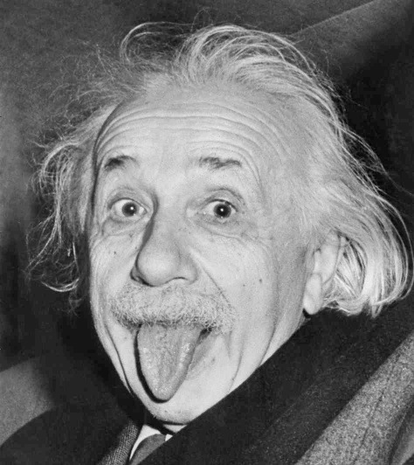

Some more realistic examples

Slide 48
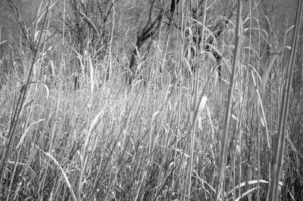

Some more realistic examples

Slide 49
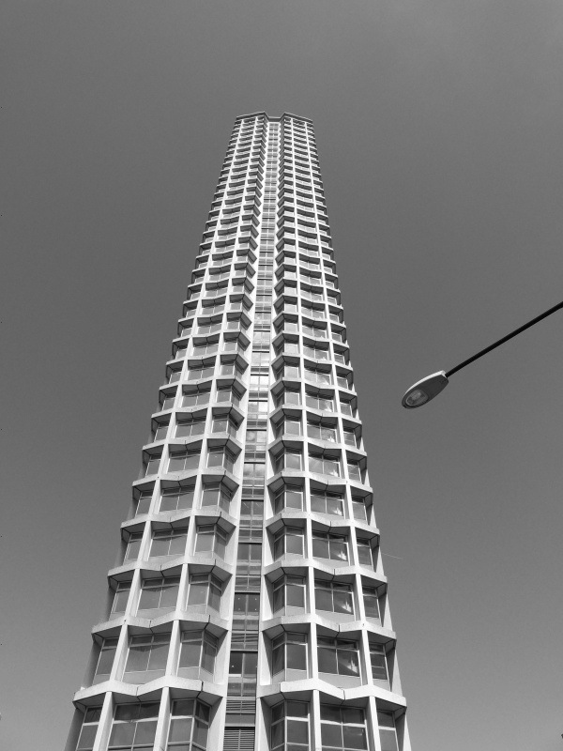
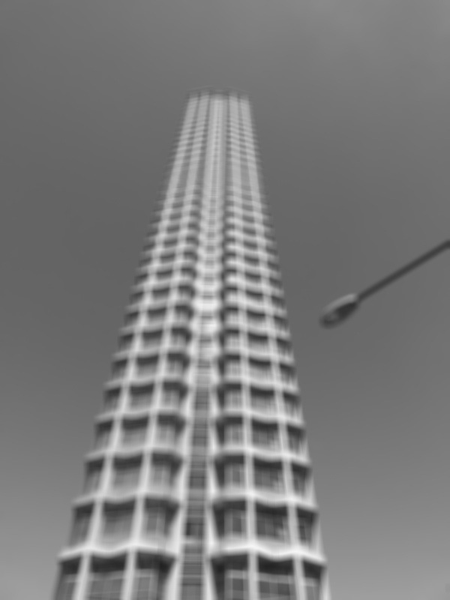
Some more realistic examples

Slide 50
Convolution

Slide 51
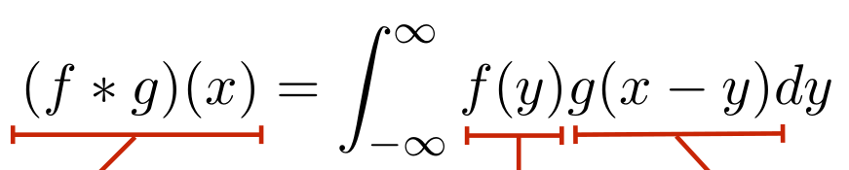
Convolution for 1D continuous signals
Definition of filtering as convolution:
notice the flip
filtered signal
filter
input signal

Slide 52
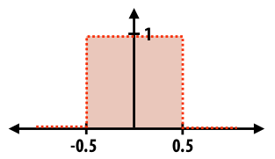
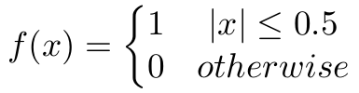
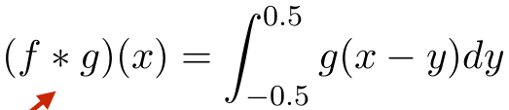
Convolution for 1D continuous signals
Definition of filtering as convolution:
notice the flip
filtered signal
filter
input signal
Consider the box filter example:
1D continuous box filter
filtering output is a blurred version of g

Slide 53
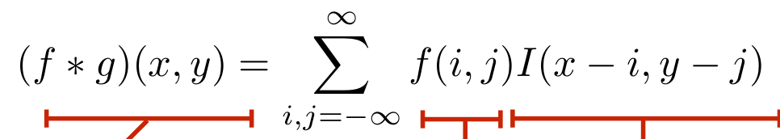
Convolution for 2D discrete signals
Definition of filtering as convolution:
notice the flip
filtered image
filter
input image

Slide 54
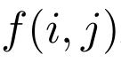
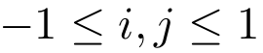
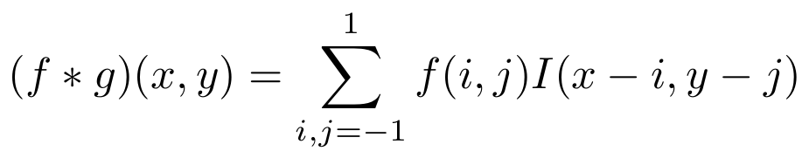
Convolution for 2D discrete signals
Definition of filtering as convolution:
notice the flip
filtered image
filter
input image
If the filter is non-zero only within , then
The kernel we saw earlier is the 3x3 matrix representation of .

Slide 55
Convolution vs correlation
Definition of discrete 2D convolution:
notice the flip
Definition of discrete 2D correlation:
notice the lack of a flip
Most of the time won’t matter, because our kernels will be symmetric.
Will be important when we discuss frequency-domain filtering.

Slide 56
Separable filters
A 2D filter is separable if it can be written as the product of a “column” and a “row”.
1 | 1 | 1
1 | 1 | 1
1 | 1 | 1
1
1
1
1 | 1 | 1
example: box filter
=
*
row
column
What is the rank of this filter matrix?

Slide 57
Separable filters
A 2D filter is separable if it can be written as the product of a “column” and a “row”.
1 | 1 | 1
1 | 1 | 1
1 | 1 | 1
1
1
1
1 | 1 | 1
example: box filter
=
*
row
column
Why is this important?

Slide 58
Separable filters
A 2D filter is separable if it can be written as the product of a “column” and a “row”.
1 | 1 | 1
1 | 1 | 1
1 | 1 | 1
1
1
1
1 | 1 | 1
example: box filter
=
*
row
column
2D convolution with a separable filter is equivalent to two 1D convolutions (with the “column” and “row” filters).

Slide 59
Separable filters
A 2D filter is separable if it can be written as the product of a “column” and a “row”.
1 | 1 | 1
1 | 1 | 1
1 | 1 | 1
1
1
1
1 | 1 | 1
example: box filter
=
*
row
column
2D convolution with a separable filter is equivalent to two 1D convolutions (with the “column” and “row” filters).
If the image has M x M pixels and the filter kernel has size N x N:
What is the cost of convolution with a non-separable filter?

Slide 60
Separable filters
A 2D filter is separable if it can be written as the product of a “column” and a “row”.
1 | 1 | 1
1 | 1 | 1
1 | 1 | 1
1
1
1
1 | 1 | 1
example: box filter
=
*
row
column
2D convolution with a separable filter is equivalent to two 1D convolutions (with the “column” and “row” filters).
If the image has M x M pixels and the filter kernel has size N x N:
What is the cost of convolution with a non-separable filter? M² x N²
What is the cost of convolution with a separable filter?

Slide 61
Separable filters
A 2D filter is separable if it can be written as the product of a “column” and a “row”.
1 | 1 | 1
1 | 1 | 1
1 | 1 | 1
1
1
1
1 | 1 | 1
example: box filter
=
*
row
column
2D convolution with a separable filter is equivalent to two 1D convolutions (with the “column” and “row” filters).
If the image has M x M pixels and the filter kernel has size N x N:
What is the cost of convolution with a non-separable filter? M² x N²
What is the cost of convolution with a separable filter? 2 x N x M²

Slide 62
A few more filters
do you see any problems in this image?
original
3x3 box filter

Slide 63
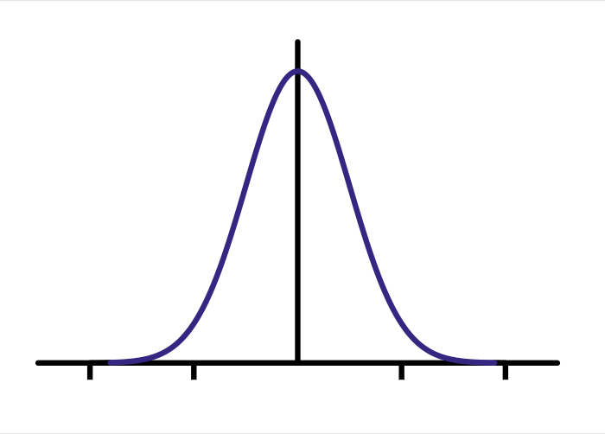
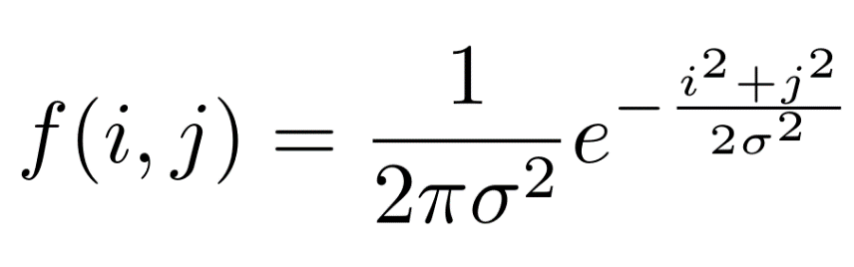
The Gaussian filter
named (like many other things) after Carl Friedrich Gauss
kernel values sampled from the 2D Gaussian function:
weight falls off with distance from center pixel
theoretically infinite, in practice truncated to some maximum distance
Any heuristics for selecting where to truncate?

Slide 64
The Gaussian filter
named (like many other things) after Carl Friedrich Gauss
kernel values sampled from the 2D Gaussian function:
Is this a separable filter?
weight falls off with distance from center pixel
theoretically infinite, in practice truncated to some maximum distance
Any heuristics for selecting where to truncate?
usually at 2-3σ
1 | 2 | 1
2 | 4 | 2
1 | 2 | 1
1
16
kernel

Slide 65
The Gaussian filter
named (like many other things) after Carl Friedrich Gauss
kernel values sampled from the 2D Gaussian function:
Is this a separable filter? Yes!
weight falls off with distance from center pixel
theoretically infinite, in practice truncated to some maximum distance
Any heuristics for selecting where to truncate?
usually at 2-3σ
1 | 2 | 1
2 | 4 | 2
1 | 2 | 1
1
16
kernel

Slide 66
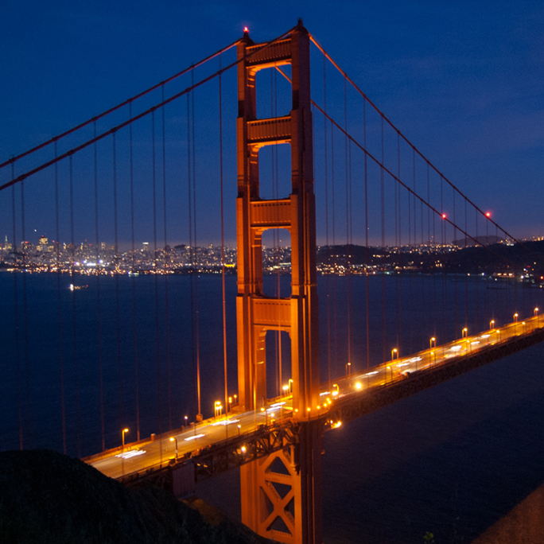

Gaussian filtering example

Slide 67


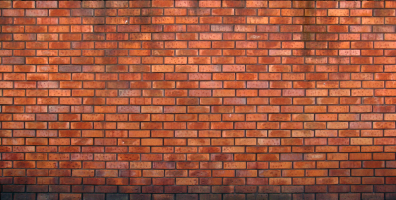
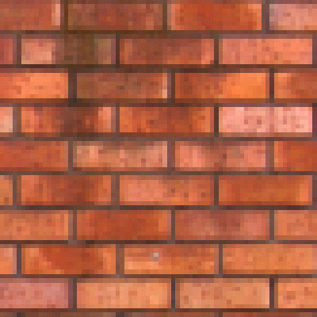


Gaussian vs box filtering
7x7 Gaussian
original
Which blur do you like better?
7x7 box

Slide 68


How would you create a soft shadow effect?

Slide 69

How would you create a soft shadow effect?
overlay
Gaussian blur

Slide 70
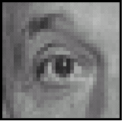
Other filters
input
filter
output
0 | 0 | 0
0 | 1 | 0
0 | 0 | 0
?

Slide 71
Other filters
input
filter
output
0 | 0 | 0
0 | 1 | 0
0 | 0 | 0
?
unchanged

Slide 72
Other filters
input
filter
output
0 | 0 | 0
0 | 1 | 0
0 | 0 | 0
?
unchanged
input
filter
output
0 | 0 | 0
0 | 0 | 1
0 | 0 | 0
?

Slide 73
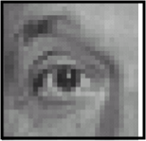
Other filters
input
filter
output
0 | 0 | 0
0 | 1 | 0
0 | 0 | 0
?
unchanged
input
filter
output
0 | 0 | 0
0 | 0 | 1
0 | 0 | 0
?
shift to left by one

Slide 74
Other filters
input
filter
output
0 | 0 | 0
0 | 2 | 0
0 | 0 | 0
1 | 1 | 1
1 | 1 | 1
1 | 1 | 1
?
-

Slide 75
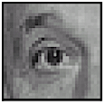
Other filters
input
filter
output
0 | 0 | 0
0 | 2 | 0
0 | 0 | 0
1 | 1 | 1
1 | 1 | 1
1 | 1 | 1
?
-
sharpening
do nothing for flat areas
stress intensity peaks

Slide 76

Sharpening examples

Slide 77
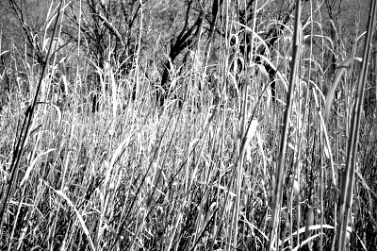
Sharpening examples

Slide 78
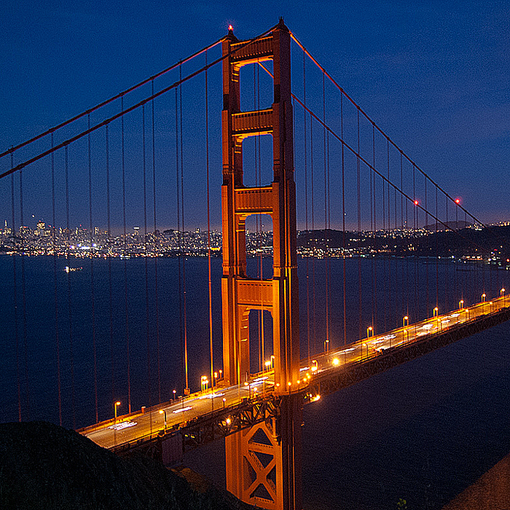
Sharpening examples

Slide 79
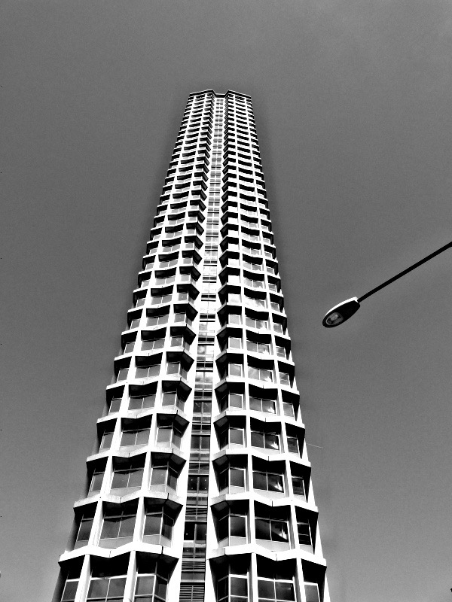
Sharpening examples
do you see any problems in this image?

Slide 80
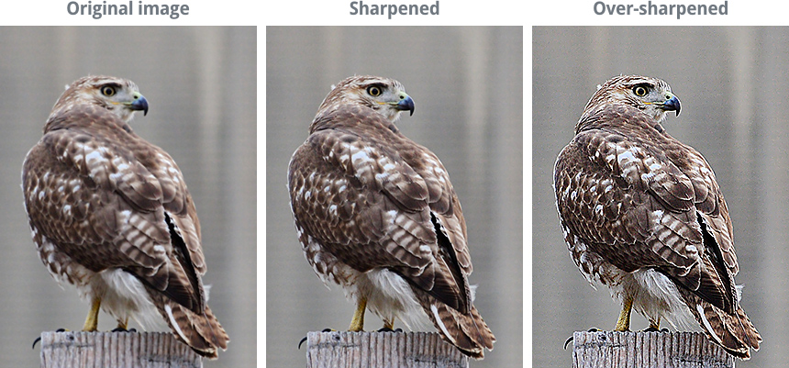
Do not overdo it with sharpening
original
sharpened
oversharpened
What is wrong in this image?

Slide 81
Image gradients

Slide 82
What are image edges?
Very sharp discontinuities in intensity.
grayscale image
domain

Slide 83
Detecting edges
How would you go about detecting edges in an image (i.e., discontinuities in a function)?

Slide 84
Detecting edges
How would you go about detecting edges in an image (i.e., discontinuities in a function)?
You take derivatives: derivatives are large at discontinuities.
How do you differentiate a discrete image (or any other discrete signal)?

Slide 85
Detecting edges
How would you go about detecting edges in an image (i.e., discontinuities in a function)?
You take derivatives: derivatives are large at discontinuities.
How do you differentiate a discrete image (or any other discrete signal)?
You use finite differences.

Slide 86

Finite differences
High-school reminder: definition of a derivative using forward difference

Slide 87


Finite differences
High-school reminder: definition of a derivative using forward difference
Alternative: use central difference
For discrete signals: Remove limit and set h = 2
What convolution kernel does this correspond to?

Slide 88
Finite differences
High-school reminder: definition of a derivative using forward difference
Alternative: use central difference
For discrete signals: Remove limit and set h = 2
-1 | 0 | 1
?
1 | 0 | -1
?

Slide 89
Finite differences
High-school reminder: definition of a derivative using forward difference
Alternative: use central difference
For discrete signals: Remove limit and set h = 2
1D derivative filter
1 | 0 | -1

Slide 90
The Sobel filter
1 | 0 | -1
2 | 0 | -2
1 | 0 | -1
1
2
1
1 | 0 | -1
=
*
1D derivative filter
Sobel filter
What filter is this?

Slide 91
The Sobel filter
1 | 0 | -1
2 | 0 | -2
1 | 0 | -1
1
2
1
1 | 0 | -1
=
*
1D derivative filter
Sobel filter
Blurring
In a 2D image, does this filter responses along horizontal or vertical lines?

Slide 92
The Sobel filter
1 | 0 | -1
2 | 0 | -2
1 | 0 | -1
1
2
1
1 | 0 | -1
=
*
1D derivative filter
Sobel filter
Blurring
Does this filter return large responses on vertical or horizontal lines?

Slide 93
The Sobel filter
Horizontal Sober filter:
1 | 0 | -1
2 | 0 | -2
1 | 0 | -1
1
2
1
1 | 0 | -1
=
*
What does the vertical Sobel filter look like?

Slide 94
The Sobel filter
Horizontal Sober filter:
1 | 0 | -1
2 | 0 | -2
1 | 0 | -1
1
2
1
1 | 0 | -1
=
*
Vertical Sobel filter:
1 | 2 | 1
0 | 0 | 0
-1 | -2 | -1
1
0
-1
1 | 2 | 1
=
*

Slide 95


Sobel filter example
original
which Sobel filter?
which Sobel filter?

Slide 96
Sobel filter example
original
horizontal Sobel filter
vertical Sobel filter

Slide 97


Sobel filter example
horizontal Sobel filter
original
vertical Sobel filter

Slide 98
Several derivative filters
1 | 0 | -1
2 | 0 | -2
1 | 0 | -1
1 | 2 | 1
0 | 0 | 0
-1 | -2 | -1
3 | 0 | -3
10 | 0 | -10
3 | 0 | -3
3 | 10 | 3
0 | 0 | 0
-3 | -10 | -3
Sobel
Scharr
1 | 0 | -1
1 | 0 | -1
1 | 0 | -1
1 | 1 | 1
0 | 0 | 0
-1 | -1 | -1
0 | 1
-1 | 0
1 | 0
0 | -1
Prewitt
Roberts
How are the other filters derived and how do they relate to the Sobel filter?
How would you derive a derivative filter that is larger than 3x3?

Slide 99


Computing image gradients
Select your favorite derivative filters.
1 | 0 | -1
2 | 0 | -2
1 | 0 | -1
1 | 2 | 1
0 | 0 | 0
-1 | -2 | -1

Slide 100


Computing image gradients
Select your favorite derivative filters.
1 | 0 | -1
2 | 0 | -2
1 | 0 | -1
1 | 2 | 1
0 | 0 | 0
-1 | -2 | -1
Convolve with the image to compute derivatives.

Slide 101



Computing image gradients
Select your favorite derivative filters.
1 | 0 | -1
2 | 0 | -2
1 | 0 | -1
1 | 2 | 1
0 | 0 | 0
-1 | -2 | -1
Convolve with the image to compute derivatives.
Form the image gradient, and compute its direction and amplitude.
gradient
direction
amplitude

Slide 102




Image gradient example
original
vertical derivative
gradient amplitude
horizontal derivative
How does the gradient direction relate to these edges?

Slide 103

How do you find the edge of this signal?
intensity plot

Slide 104

How do you find the edge of this signal?
intensity plot
Using a derivative filter:
derivative plot
What’s the problem here?

Slide 105

Differentiation is very sensitive to noise
When using derivative filters, it is critical to blur first!
input
Gaussian
blurred
derivative of blurred
How much should we blur?

Slide 106


Derivative of Gaussian (DoG) filter
Derivative theorem of convolution:
input
derivative of Gaussian
How many operations did we save?
Any other advantages beyond efficiency?
output (same as before)

Slide 107

Laplace filter
Basically a second derivative filter.
We can use finite differences to derive it, as with first derivative filter.
first-order
finite difference
1D derivative filter
1 | 0 | -1
second-order
finite difference
Laplace filter
?

Slide 108
Laplace filter
Basically a second derivative filter.
We can use finite differences to derive it, as with first derivative filter.
first-order
finite difference
1D derivative filter
1 | 0 | -1
second-order
finite difference
Laplace filter
1 | -2 | 1

Slide 109

Laplacian of Gaussian (LoG) filter
As with derivative, we can combine Laplace filtering with Gaussian filtering
input
Laplacian of Gaussian
output
?

Slide 110
Laplacian of Gaussian (LoG) filter
As with derivative, we can combine Laplace filtering with Gaussian filtering
input
Laplacian of Gaussian
output
“zero crossings” at edges

Slide 111


Laplace and LoG filtering examples
Laplacian of Gaussian filtering
Laplace filtering

Slide 112

Laplacian of Gaussian vs Derivative of Gaussian
Laplacian of Gaussian filtering
Derivative of Gaussian filtering

Slide 113
Laplacian of Gaussian vs Derivative of Gaussian
zero-crossing
peak
Laplacian of Gaussian filtering
Derivative of Gaussian filtering
Zero crossings are more accurate at localizing edges (but not very convenient).

Slide 114






2D Gaussian filters
Gaussian
Derivative of Gaussian
how does this relate to this lecture’s cover picture?
Laplacian of Gaussian

Slide 115


Slide 116


Slide 117


Slide 118
Image credit: https://towardsdatascience.com

Slide 119
3.Non-Maximum Suppression
Image credit: https://towardsdatascience.com

Slide 120
a) Pixel One
b) Pixel Two
Image credit: https://towardsdatascience.com

Slide 121


Slide 122


Slide 123
Image credit: https://towardsdatascience.com

Slide 124


Slide 125
References
Basic reading:
Szeliski textbook, Section 3.2

